Slide 1
Azure SQL Data Warehouse

Slide 2
Contents
Overview
Architecture
Scaling
Schema Design
Loading
Querying
High-Availability
Backup & Disaster Recovery
Monitoring, Management
Security
Sizing
Migration
Best Practices
Pricing

Slide 3
Azure SQL Data Warehouse Overview

Slide 4
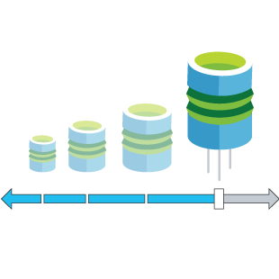


Azure SQL Data Warehouse
Enables transformative insights
Scales in minutes
with more freedom
Helps secure
and protect
Gets you up
& running quickly
Enables transformative insights
Near real-time analytics over structured and unstructured data
Use tools you know and love; Excel Power BI, Tableau, Qlik or 20 others
Seamless compatibility with Azure ingestion, machine learning, and Big Data services
Easily scale your workload in minutes
Decoupled storage and compute; pay for only the compute you use
Innovative “Pause” feature to stop compute and save even more
Multiple layers of data protection
Encryption at rest, in motion or in use
Tools to monitor data security
Protect user access to data with Azure Active Directory
A single SQL-based view across data sources
Seamlessly ingest data from on-premises, cloud, devices, and apps
Built on SQL Server technology using tools you know love SSMS and Visual Studio SSDT

Slide 5

Cortana Intelligence Suite
Information Management
Big Data Stores
Machine Learning and Analytics
Intelligence
Data Sources
People
Data Factory
Data Lake Store
Machine Learning
Cognitive Services
SQL Data
Warehouse
Data Lake Analytics
Bot Framework
Data Catalog
Web
Apps
HDInsight
(Hadoop and Spark)
Event Hubs
Cortana
Mobile
Apps
Stream Analytics
Bots
Dashboards & Visualizations
Sensors and devices
Power BI
Automated Systems
Data
Intelligence
Action

Slide 6
Key differentiators
Compute
Azure SQL Data Warehouse
SQL DW
Storage
Notes:
Other providers force you to choose between having a lot of storage, or a lot of compute.
With Microsoft your resources are truly scalable.
In addition, you can spin up and spin down as needed, saving resources and time, without having to take everything offline in order to add or reduce capacity.

Slide 7







Scale compute on the fly when you need it
Data Warehouse Units (DWUs) are a measure of reserved compute performance or ‘power.’ A customer’s DWU needs can vary depending on the needs of their workload.
“Getting featured in the iOS App Store was a big deal for a small company like ours as our users increased from 3,000 to 300,000 in 48 hours. To keep up with this 100x increase in workload, we simply added data warehouse compute capacity by moving a slider and our services just scaled in minutes—we didn’t miss an insight.”
Paul Ohanian, CTO, Pound Sand
100
200
300
400
500
600
1000
1200
1500
2000
3000
6000
DATA WAREHOUSE UNITS (DWUS)

Slide 8
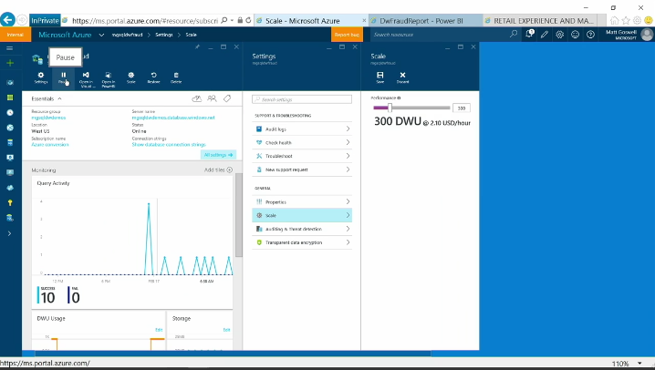
…pause compute when you don’t need it
No need to over-provision or over-pay
More freedom to right-size your environment
Pause
Bring all your data with no tradeoffs on what data to ingest - run compute only on the datasets that matter
“When we learned about the pause and resume capabilities of SQL Data Warehouse, we switched from AWS Redshift, migrating over 25TB of uncompressed data over a week for the simple reason of saving money. To meet our business intelligence requirements, we load data once or twice a month and then build reports for our customers. Not having the data warehouse service running all the time is key for our business and our bottom line.”
Bill Sabo, Integral Analytics.

Slide 9
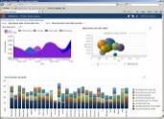



Query unstructured data via PolyBase/T-SQL
SQL Server
SQL DW instance
PolyBase
Hadoop VMs /
Azure Storage
Scale out compute
Any data, any size, anywhere
Notes:
Enables query capabilities across common Hadoop distributions (HDP & Cloudera) and Hadoop file formats in Azure storage.
Polybase for querying & managing non-relational Hadoop and relational data
Allows leveraging existing SQL skills and BI tools
Supports multiple non-relational file formats
Improved time-to-insights & simplified ETL

Slide 10

Automatic backup and geo-restore Recover from data deletion or alteration or disaster
Auto backups, every 4 to 8 hours
Restore using REST API, PowerShell or Azure Portal
Local and geo-redundant backups
Backups retention policy:
Auto backup retention for 7 days
SQL Data Warehouse backups
Azure Storage
Geo- replicated
sabcp01bl21
sabcp01bl21
Restore from backup
Notes:
https://docs.microsoft.com/en-us/azure/sql-data-warehouse/sql-data-warehouse-backups

Slide 11

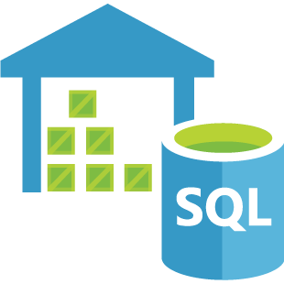

Auditing and Threat Detection
Gain real-time insights and streamline compliance-related tasks
RETAIN an audit trail of selected events and activities
REPORT on database activity—preconfigured reports and a dashboard help get you started quickly
ANALYZE reports to find suspicious events, unusual activities, and trends
RECEIVE PROACTIVE ALERTS about activities that might indicate potential security threats using the new Threat Detection feature
Malicious insider
Azure SQL Data Warehouse
External attacker
Suspicious activities
Threat
Detection
Alerts and Reports
Auditing
Audit log
Authorized admin
Azure Storage

Slide 12
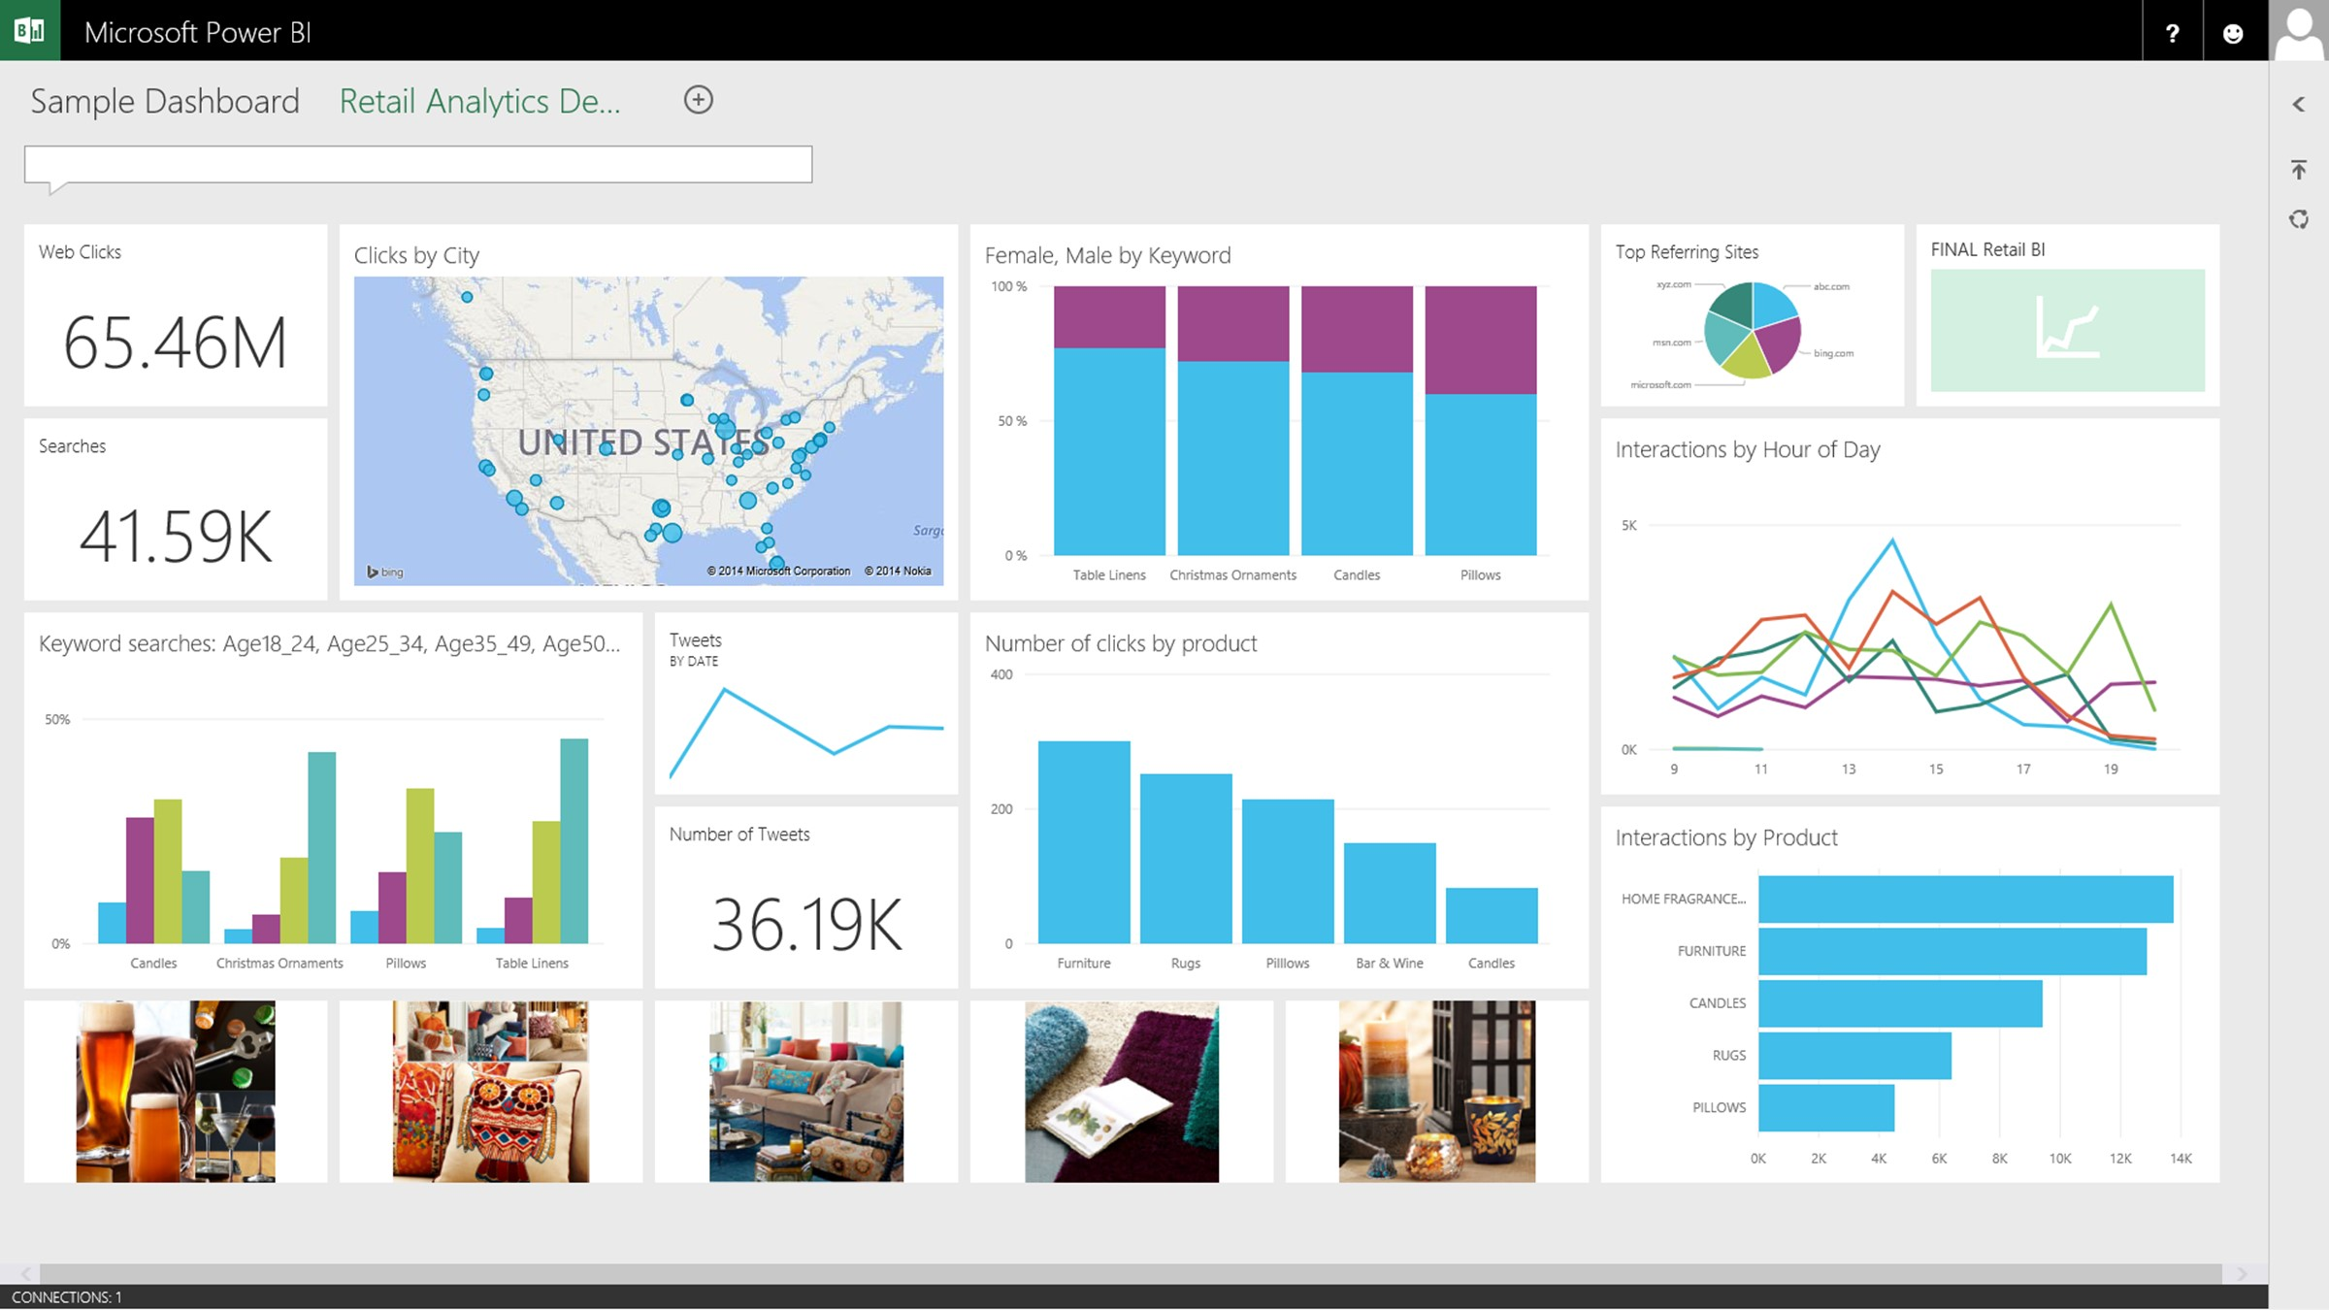

End to end platform built for the cloud
Hadoop
SQL
Azure SQL Data Warehouse
Azure SQL Database
App Service
Power BI
Intelligent App
Azure Machine Learning
Notes:
A customer can take data requirements, execute their processes on their data, their way.
Integration of end-end data scenario
Use data from any source
Ingest into SQL DW where it’s stored
Then is available to other cloud and on-premises solutions and services, including
Azure SQL DB, ML, Visualization like Power BI and Hadoop

Slide 13

Your choice of language and tooling
SQL Server Azure SQL Database SQL DW
ADO.NET
JDBC
ODBC
PHP Driver
db-lib
Node.js Driver
Tedious Node.js Driver
Pymssql
Django
TinyTDS
Rails
Pymssql
TinyTDS
ODBC
FreeTDS
ODBC
FreeTDS
FreeTDS
C#
VB.NET
Java
C/C++
PHP
JavaScript
Python
Ruby

Slide 14
SQL DW – Fit for Purpose
Designed for DW and not OLTP. All the traditional DW workload characteristics apply.
Not good for singleton DML heavy operations, Example: Clients issuing singleton update, insert, delete.
Incremental data is loaded regularly by ETL/ELT process in batch mode. Not optimal for real time ingestion.
Low number of concurrent queries.
Where data runs in Millions, Billions of rows and TBs in Size.
Main performance is driven from Massively parallel processing Architecture.

Slide 15
Azure SQL Data Warehouse Architecture

Slide 16
MPP architecture - Concepts
Massively Parallel Processing
A divide and conquer, distributed computing strategy
Shared Nothing architecture
Scale-out architecture (versus scale-up)
Take one big problem & break it up & execute it individually
Team approach “Many hands make light work”
Multiple machines (RAM, CPU, Storage) with high bandwidth for single task
Codeless parallel processing
Best suited for large data processing
Out of the box -
Task Scheduling, Distribution, Communication & Co-ordination
High Availability, Fault Tolerance
Notes:
SMP:
Multiple CPUs are used to complete individual processes simultaneously
All CPUs share the same memory (SMP) OR different Groups of CPUs use different sets of memory on the same machine (NUMA)
All SQL Server implementations up until now have been SMP/NUMA
MPP:
Multiple Nodes (computers) get utilized to process a single task
Many separate CPUs running in parallel across multiple nodes to execute a single task
Each set of CPUs has its own memory
Applications must be segmented, using high-speed communications between nodes

Slide 17
MPP architecture - Concepts
Logical layer
Physical layer
Distributed
Query engine
Lots of machines!
Holds application metadata, Does not persist application data
Persists application data
Parallel processing coordination
Lots of small databases running in parallel
Receives intermediate results and performs final aggregation
Performs query steps as instructed

Slide 18
Azure SQL Data Warehouse Architecture
Application or User connection
SQL DB
Data Movement Service (DMS) Runs on all nodes
Data Loading
(SSIS, REST, OLE, ADO, ODBC, WebHDFS, AZCopy, PS)
Control
Node
DMS
Massively Parallel Processing (MPP) Engine
Compute
Scale compute up or down when required
Pause, Restart, Stop, Start.
DMS
DMS
DMS
DMS
SQL DB
SQL DB
SQL DB
SQL DB
Compute
Node
Compute
Node
Compute
Node
Compute
Node
Azure Infrastructure and Storage
Storage
Storage
Add\Load data to WASB(S) without incurring compute costs

Slide 19
Azure SQL Data Warehouse – Control Node
SQL DB
SQL DB
Control
Node
Massively Parallel Processing (MPP) Engine
Control
Node
SQL DB
SQL DB
SQL DB
SQL DB
Compute
Node
Compute
Node
Compute
Node
Compute
Node
Endpoint for connections
Runs a shell database
Regular SQL endpoint (TCP 1433)
Persists no user data, just metadata only and statistics
Coordinates compute activity using MPP engine and DMS
Storage

Slide 20
Control node
Accepts requests from user and transforms it into separate queries that run on each compute node in parallel
Coordinates all of the data movement and computation required to run parallel queries
Interprets requests for scale-out
Orchestrates actions / steps
Final computation
Returns result
Runs SQL Server
Stores metadata, statistics
Performs final computation
Requires distributed
query engine

Slide 21
Azure SQL Data Warehouse - Compute Nodes
SQL DB
SQL DB
Control
Node
Massively Parallel Processing (MPP) Engine
Compute
Node(s)
SQL DB
SQL DB
SQL DB
SQL DB
Compute
Node
Compute
Node
Compute
Node
Compute
Node
Azure SQL Database
Storage
An increase of DWU will increase the number of compute nodes

Slide 22
Compute node
Power behind the SQL DW; Performs the heavy lift
Accepts requests from control node
Is a highly tuned SMP System
Optimises requests from control node
SQL Databases that store data
Workers that run parallel queries on data
No direct user interaction
Uses SQL Server

Slide 23
Azure SQL Data Warehouse – premium storage
Control
Node
Massively Parallel Processing (MPP) Engine
SQL DB
SQL DB
SQL DB
SQL DB
Premium RA-GRS storage
SSD-based
Better latency
Reliable I/O – 400 MB/sec per node
Persist the data without incurring compute costs
Compute
Node
Compute
Node
Compute
Node
Compute
Node
Storage

Slide 24
SQL DW Storage - Page blobs
Azure SQL DW is backed by SSD based page blobs
Page blobs – optimized for representing IaaS disks
Supports random writes, up to 1 TB in size
Premium page blobs – optimized for I/O intensive workloads
Premium page blob is LRS (Locally Redundant Storage) only
https://docs.microsoft.com/en-us/rest/api/storageservices/fileservices/understanding-block-blobs--append-blobs--and-page-blobs

Slide 25

SQL DW Control Architecture
SQL DW uses SQL Server on the Control node to run a “shell appliance”
Every database with all its objects exists in the shell appliance as an empty “shell,” lacking the user data (which sits on all the compute nodes)
Every DDL operation is executed against both the shell and the compute nodes
Large parts of basic RDBMS functionality provided by that shell
Authentication and authorization of queries, but also the full security system
Schema binding
Metadata catalog
SELECT
SELECT
Engine Service
Shell Appliance
(SQL Server)
foo
Control Node
Plan Steps
Plan Steps
Plan Steps
Compute Node
(SQL Server)
Compute Node
(SQL Server)
Compute Node
(SQL Server)
foo
foo
foo

Slide 26


Logical overview
Control
Compute
Storage

Slide 27
Distributed queries
Query
Result
Control
Compute
Storage

Slide 28
Simple Example
SELECT COUNT_BIG(*)
FROM dbo.[FactInternetSales];
SELECT SUM(*)
FROM dbo.[FactInternetSales];
Control
Compute
SELECT COUNT_BIG(*)
FROM dbo.[FactInternetSales];
SELECT COUNT_BIG(*)
FROM dbo.[FactInternetSales];
SELECT COUNT_BIG(*)
FROM dbo.[FactInternetSales];
SELECT COUNT_BIG(*)
FROM dbo.[FactInternetSales];

Slide 29
Partial Parallelism
Performed in parallel across compute nodes
Performed in series across the distributions
Guarantees transactional behaviour
Examples: INSERT, UPDATE, DELETE

Slide 30
Full Parallelism
Performed in parallel across compute nodes
Performed in parallel across the distributions
Used for
New object creation
Reading data from a distributed table
Examples:
CTAS (Create Table As Select)
SELECT Statements

Slide 31
Azure SQL Data Warehouse Scaling

Slide 32
Data warehouse unit (DWU)
Measure of power
Simply buy the query performance you need, not just hardware
Transparency
Quantified by workload objectives: how fast rows are scanned, loaded, copied
On demand
First DW service to offer compute power on demand, independent of storage
100 DWU*
Scan Rate | 3.36M row/sec
Loading Rate | 130K row/sec
Table Copy Rate | 350K row/sec
Scan 1B rows*
100 DWU | = | 297 sec
400 DWU | = | 74 sec
800 DWU | = | 37 sec
1,600 DWU | = | 19 sec
* Preliminary estimates; actual results may change
Notes:
TH to edit – make it look nicer

Slide 33
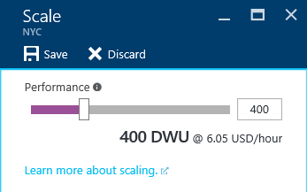
Data Warehouse Units (DWU)
CPU
DWU
DW100
DW200
DW300
DW400
DW500
DW600
DW1000
DW1200
DW1500
DW2000
DW3000
DW6000
ALTER DATABASE ContosoDW MODIFY
(service_objective = 'DW1000');
RAM
I/O

Slide 34
SQL DW Scaling
Changing to
DW1000
DW500
Queries
Control
Engine
DMS
DMS = Data Movement Service
SQL DB
Compute
Compute
Compute
Compute
Compute
DMS
DMS
DMS
DMS
DMS
SQL DB
SQL DB
SQL DB
SQL DB
SQL DB
Dist_DB_1
Dist_DB_2
Dist_DB_12
Dist_DB_13
Dist_DB_14
Dist_DB_24
Dist_DB_25
Dist_DB_26
Dist_DB_36
Dist_DB_37
Dist_DB_38
Dist_DB_48
Dist_DB_49
Dist_DB_50
Dist_DB_60
…
…
…
…
…
Dist_DB_1.mdf
Dist_DB_13.mdf
SSD storage
Dist_DB_37.mdf
Dist_DB_49.mdf

Slide 35
SQL DW Scaling
DW1000
Changing to
DW1000
Queries
Control
Engine
DMS = Data Movement Service
DMS
SQL DB
Compute
Compute
Compute
Compute
Compute
Compute
Compute
Compute
Compute
Compute
DMS
DMS
DMS
DMS
DMS
DMS
DMS
DMS
DMS
DMS
SQL DB
SQL DB
SQL DB
SQL DB
SQL DB
SQL DB
SQL DB
SQL DB
SQL DB
SQL DB
Dist_DB_1
Dist_DB_2
Dist_DB_6
Dist_DB_7
Dist_DB_8
Dist_DB_12
Dist_DB_13
Dist_DB_14
Dist_DB_18
Dist_DB_19
Dist_DB_20
Dist_DB_24
Dist_DB_25
Dist_DB_26
Dist_DB_30
Dist_DB_31
Dist_DB32
Dist_DB_26
Dist_DB_37
Dist_DB_38
Dist_DB_42
Dist_DB_43
Dist_DB_44
Dist_DB_48
Dist_DB_49
Dist_DB_50
Dist_DB_54
Dist_DB_55
Dist_DB_56
Dist_DB_60
…
…
…
…
…
…
…
…
…
…
Dist_DB_1.mdf
Dist_DB_13.mdf
Blob storage [WASB(S)]
Dist_DB_37.mdf
Dist_DB_55.mdf

Slide 36
Azure SQL Data Warehouse Sizing

Slide 37
Compute Sizing Sizing by capacity
Recommended starting point
Flexibility to select any range of DWUs
>160 TBs
80-160 TBs
60-80 TBs
48-60 TBs
36-48 TBs
20-36 TBs
16-20 TBs
12-16 TBs
8-12 TBs
4-8 TBs
0-4 TBs
100
200
300
400
500
600
1000
1200
1500
2000
3000
6000

Slide 38
Compute sizing factors
Concurrency
Transaction size
Load
Memory
Data Warehouse Unit (DWU)

Slide 39
Compute sizing Concurrency: queries
QID
QID
32
active queries
1024
open sessions
QID
QID
QID
QID

Slide 40
Compute sizing Load scaling
30-32 MB/Sec/Node
110-115 GB/Hour/Node

Slide 41

Compute sizing Loading delimited text
A compressed text file cannot be read
in parallel
Splitting data across multiple files maximises load performance

Slide 42
Storage sizing Data locations
Billed to customer
Local
Premium
Blob
Tempdb
Data files
Geo-backup
Log files
Snapshots

Slide 43
Storage sizing Local Storage: Temp db sizing
~399GB
per DW100

Slide 44
Storage sizing Premium storage: Capacity limits
240TB
File capacity
5x
CCI compression
>1PB
Db capacity

Slide 45
Storage sizing Premium Storage: Database Size
Unallocated
Unused
Total DB Size
Index
Reserved
Space
Used
Space
Data
Log

Slide 46
Storage sizing Premium Storage: Snapshots
Frequency
Retention
4
hours
7
days
RPO : 8 Hours

Slide 47
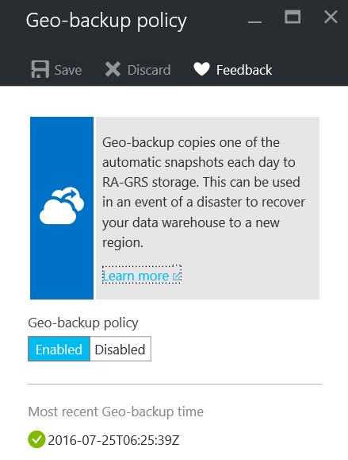
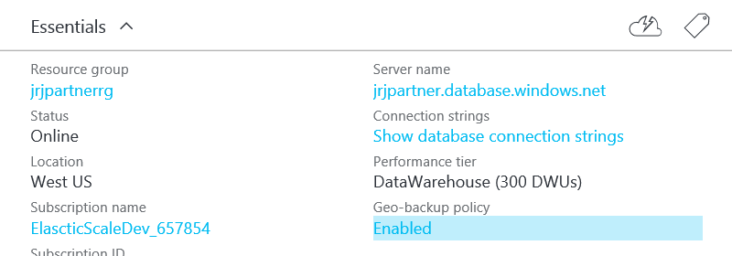
Storage sizing Blob Storage: Geo-redundant backups
Frequency and Retention
1
Geo-backup
24hr
RPO

Slide 48
Storage sizing Capping storage capacity
CREATE DATABASE MyDB COLLATE SQL_Latin1_General_CP1_CI_AS (
EDITION = 'DataWarehouse', SERVICE_OBJECTIVE = 'DW400',
MAXSIZE = 10240 GB );
ALTER DATABASE MyDB
MODIFY (MAXSIZE = 245760 GB);

Slide 49
Storage sizing Summary
Database size:
sp_spaceused
Table sizing:
DMVs
Snapshot size:
Total storage size (portal) – database size (sp_spaceused)
Free space (unallocated):
sp_spaceused

Slide 50
Azure SQL Data Warehouse Schema Design

Slide 51
Distributed Data = Buckets of Water
Evenly spreading the data leads to even use application resources
Notes:
Each distributed data location = a bucket of data
Each bucket is called a distribution
Each distribution:
maps to a physical table
allocated physical space
contains all rows that have the same distribution value

Slide 52
Table Distribution Options
Hash Distributed
Round Robin
(Default)
Replicated
(Future improvement)
Data divided across nodes based on hashing algorithm
Same value will always hash to same distribution
Single column only
Data distributed evenly across nodes
Easy place to start, don’t need to know anything about the data
Simplicity at a cost
Data repeated on every node
Simplifies many query plans and reduces data movement
Best with joining hash table
Check for Data Skew, NULLS, -1
Will incur more data movement at query time
Consumes more space
Joining two Replicated Table runs
on one node

Slide 53
Selecting a Distribution Method
For large fact tables, best option is to Hash Distribute
Distribute on column that is joined to other fact tables
Primary or surrogate key
However, be mindful of …
Hash column should have highly distinct values (Minimum 60 distinct values)
Avoid distributing on a date column
Avoid distributing on column with high frequency of NULLs and default values (e.g. -1)
Distribution column is NOT updatable
For compatible joins use the same data types for two distributed tables
If there are no distribution columns that make sense, then use Round Robin as last resort

Slide 54
Dimension Table
Small dimension table (< 60M rows)
Clustered index
Round Robin
Future Improvement - Choose replicate option when it becomes available
Large dimension table
Same design as fact table
Clustered columnstore (by default) and distribute on join key

Slide 55
Optimizing with Indexes
Heap
Clustered Column Store (SQL DW Default)
Heap
Clustered Index
Optimal choice for large tables
Limits scans to columns in the query
Optimal compression
Slower to load than Heap
Keep partitions large enough to compress (> 1 million rows)
Optimal choice for temporary or staging tables
Also good for table with less than 60 million rows
Optimal for tables < 60M rows
Sorting operation slows down load
Optimal choice for temporary or staging tables
Fastest load performance
Non-clustered Indexes
Use sparingly
Optimize single row lookups
Will slow down load

Slide 56
Partitioning
Partition on date column for archiving purposes
Improves performance by partition elimination
Partition granularity depends on your workload
Reload, re-process
Aim for min 100K, optimal 1 million rows per distribution/partition (remember the 60 databases)
Optimize load performance through partition switching
Considers different grain partitions if you have hot/cold data in different tables
Example: Hot data daily, cold data monthly
Keep the number of partitions “reasonable” as there are overheads
Re-indexing by partition when needed

Slide 57
DDL Example
CREATE TABLE FactFinance
(
FinanceKey int NOT NULL,
DateKey int NOT NULL,
OrganizationKey int NOT NULL,
DepartmentGroupKey int NOT NULL,
ScenarioKey int NULL,
AccountKey int NULL,
Amount float NOT NULL)
WITH (clustered columnstore index, DISTRIBUTION = HASH(FinanceKey),
PARTITION (DateKey RANGE RIGHT FOR VALUES
(20100101,20200101,20300101))
);

Slide 58
Optimizing with Statistics
Create and Update of Statistics are NOT yet automatic
Cost Based Query Optimizer needs statistics
Sampled stats are usually just fine
Create statistics for all columns used in JOINs, GROUP BY, WHERE
Update statistics after incremental load
If needed, use multi-column statistics on join and group by
create statistics l_orderkey on [dbo.lineitem] (l_orderkey);
select * from sys.stats where name = ‘l_orderkey’;
dbcc show_statistics ("lineitem","l_orderkey");

Slide 59
Azure SQL Data Warehouse Loading

Slide 60
Data Loading Options
PolyBase
BCP
Import/Export
SSIS
Azure Data Factory
Redgate Platform
…

Slide 61
Best Practices – Data Loading
Polybase is the fastest method
Upload to BLOB via AZCOPY or Powershell library
History – use CTAS
Incremental – use INSERT INTO
Use the highest resource class without sacrificing concurrency
Increase DWU during load, decrease when done
Known Issues:
Do not support extended ASCII, UTF-16.
Do not support custom multi-date format. E.g. 2000-1-6
No reject files/reason for rejected rows.

Slide 62
PolyBase Characteristics
A single PolyBase load provides best performance for non-compressed text files.
The load performance scales as you increase DWUs.
Parallelizes the data load process, no need to explicitly break the input data into multiple files and issue concurrent loads.
Each reader will slice 512 MB block from data files.
Max throughput will depend on number of readers available on the SLO you use.
Multiple readers will not work against a compressed text file (gzip). Only a single reader is used per compressed file since uncompressing the file in the buffer is single threaded. Alternatively, generate multiple compressed files.
The number of files should be greater than or equal to the total number of readers of your service level objective (SLO).

Slide 63
Loading Options
PolyBase | BCP | Import/Export | SSIS | ADF
Fastest and preferred load option. Use CTAS for initial load. Use INSERT/INTO for incremental load or CTAS into stage table and partition switch into final table. | Use only for small files < 10 GB. Limited retry logic. Does not scale as you increase DWU (single thread, single CPU on client). Increase parallel threads to improve performance. | Recommended for > 10TB. Put data on encrypted Disks and ship to Microsoft. Microsoft loads the data into SQL DW. | Increase client timeout at least 10 min, default 30 sec. Increase parallel threads to improve performance. Slight performance improvement & greater reliability if run on VM. | A simpler way to use PolyBase. Quick to configure since you don’t need to define the T-SQL objects.

Slide 64
Azure SQL Data Warehouse Querying

Slide 65
Common Data Movement Types
DMS Operation | Description
ShuffleMoveOperation | Redistributes data for compatible join or aggregation
PartitionMoveOperation | Data moves from compute to control node
BroadcastMoveOperation | Table needs to become replicated for join compatibility

Slide 66
Best Practices – Query Performance
Check for SKEW (DBCC PDW_SHOWSPACEUSED)
Statistics
CETAS or CTAS large return operation
De-normalize if needed
DSQL Query Plan
Minimize data movement operations
Distribution & aggregation compatible
Minimize size of data movement
Check for predicate pushdown. Rewrite query if needed
Use higher resource class for memory intensive queries
Load large external tables rather than querying directly

Slide 67
Azure SQL Data Warehouse High Availability

Slide 68
High Availability – Out of the Box
Storage
Backed by premium LRS
Three copies are maintained, intra-datacenter for fault tolerance
Replicas are served in the event of failures by the framework automatically
Compute
Service Fabric container backbone
Compute nodes run on containers
No replicas maintained, new container is served up from container pool
Less than a minute to provision
Framework seamlessly restores

Slide 69
Azure SQL Data Warehouse Backup and Disaster Recovery

Slide 70

Snapshots – out of the box
Automatically scheduled to run every 4 – 8 hours
Snapshot is incremental
Saved to premium LRS (Locally Redundant Storage)
Retention period is 7 days
Point-in-time restore configurable
Snapshots are taken only when NOT paused
Snapshots cannot be invoked programmatically
RPO is 8 hours
Workarounds available to keep snapshots older than 7 days
.Net to programmatically create snapshot
Query to see when last snapshot started →
Notes:
Create snapshot programmatically:
https://azure.microsoft.com/en-us/documentation/articles/storage-blob-snapshots/

Slide 71
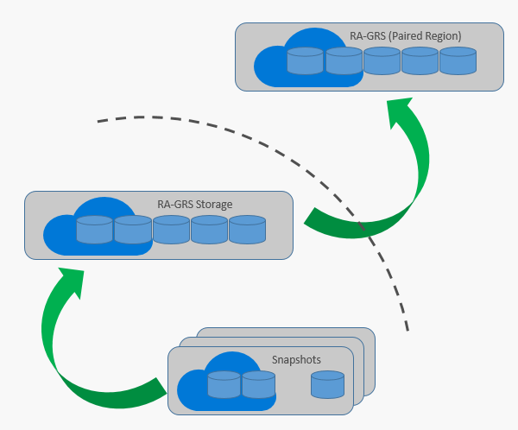
Back up to DR datacenter – out of the box
Features:
Scheduled to run every 24 hours
On by default, can opt-out
RPO is 24 hours
Full warehouse backup – only 1 backup copy
Access your geo-backup from either the primary or the secondary location
Backup Process:
Copies latest snapshot to a RA-GRS storage account (standard) in primary data center
Data in this RA-GRS account gets replicated to paired Geo-DR center automatically

Slide 72
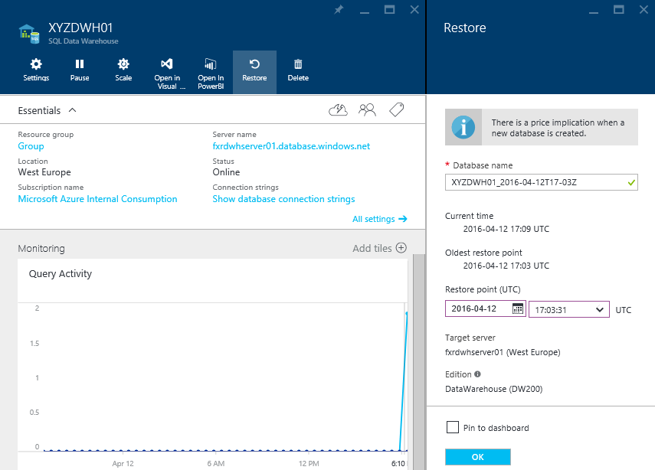
SQL DW – Restore (3 Methods)
Azure Portal (Method 1)

Slide 73
SQL DW – Restore (3 Methods)
Rest API (Method 2)
List all of your restorable deleted databases by using the List restorable dropped databases operation.
Get the details for the deleted database you want to restore by using the Get restorable dropped database operation.
Begin your restore by using the Create database restore request operation.
Track the status of your restore by using the Database operation status operation.

Slide 74
SQL DW – Restore (3 Methods)
Powershell (Method 3)
Select the subscription under your account that contains the database to be restored.
List restore points for the database (requires Azure Resource Management mode)
Pick the desired restore point using the RestorePointCreationDate.
Restore the database to the desired restore point.
Monitor the progress of the restore.

Slide 75
Azure SQL Data Warehouse Security

Slide 76
Security
Authentication
Authorization
Data Protection
Connection Security
SQL Server authentication
Azure Active Directory
Create administrator user at provision time, then create users for SQL Server authentication
Same model as SQL Server – role, role memberships, permissions
Transparent data encryption at rest – AES 256 bit
Microsoft managed certificates and periodic rotation (90 days) by Microsoft
Encrypted configuration, automatically results in encrypted Geo-DR backup, local snapshots, metadata and log files
Encrypt using portal or T-SQL
Firewall rules used by both the server and the database to reject connection attempts from IP addresses that have not been explicitly whitelisted
Set up server-level firewall rule to enable client access

Slide 77
Auditing & Threat Detection
Auditing
Threat Detection
Audit log persisted in storage account
Retain an audit trail of selected events by defining categories
Report on database activity including some pre-configured reports.
Excel dashboard template available
Find suspicious events, unusual activity and trends
A new layer of security
Detect and respond to potential threats as they occur by providing alerts on anomalous activities
Makes it simple to address potential threats without a need for a security expert

Slide 78
Azure SQL Data Warehouse Best Practices

Slide 79
Best practice
Cost management:
Reduce cost with pause and scale down
Pausing/scaling:
Drain transactions prior to pausing/scaling
Statistics:
Maintain statistics for performance
External tables:
Save locally, then query (versus PolyBase query)
Notes:
Pause compute resources, - https://azure.microsoft.com/en-us/documentation/articles/sql-data-warehouse-manage-compute-overview/#pause-compute-bk
Resume compute resources, - https://azure.microsoft.com/en-us/documentation/articles/sql-data-warehouse-manage-compute-overview/#resume-compute-bk
Scale compute resources - https://azure.microsoft.com/en-us/documentation/articles/sql-data-warehouse-manage-compute-overview/#scale-performance-bk
Manage table statistics - https://azure.microsoft.com/en-us/documentation/articles/sql-data-warehouse-tables-statistics/
CREATE STATISTICS - https://msdn.microsoft.com/library/ms188038.aspx
UPDATE STATISTICS - https://msdn.microsoft.com/library/ms187348.aspx

Slide 80
Best practice
Scaling:
Check DMV sys.dm_pdw_exec_requests before “Change SLO” to make sure no running requests
Loading:
Use PolyBase
Scaling provides additional readers/IO
CTAS to a partition and switch partition
Use appropriate resource class for bulk insert
No singleton inserts - Batch single row inserts into larger loads
Export:
Use PolyBase

Slide 81
Best practice
Querying:
Keep up to date statistics
Choose distributions carefully
Size resource classes appropriately
Avoid querying external tables, load to local and then query
Use DMVs to monitor and optimize queries
Upgrading:
Use minimally logged operations for fast recovery Build retries into applications/processes
Availability:
Build retries into applications/processes
Notes:
Data Management Views:
https://azure.microsoft.com/en-us/documentation/articles/sql-data-warehouse-manage-monitor/

Slide 82
Best practice
Partitioning:
Avoid over-partitioning – leads to poor performance
If you issue - create 100 partitions, it translates to 100*60, 6000 partitions
Plan for 1M rows per partition to leverage clustered columnstore
Transactions:
- Minimize transaction sizes
- Leverage special minimal logging cases, like CTAS, TRUNCATE, DROP TABLE or INSERT to empty tables, to reduce rollback risk
- For unpartitioned tables consider using a CTAS to write the data you want to keep in a table rather than using DELETE
- For partitioned tables, use Metadata Only operations like partition switching for data management
Notes:
Partitioning:
https://azure.microsoft.com/en-us/documentation/articles/sql-data-warehouse-tables-partition/
Transactions:
For example, rather than execute a DELETE statement to delete all rows in a table where the order_date was in October of 2001, you could partition your data monthly and then switch out the partition with data for an empty partition from another table (see ALTER TABLE examples).
Understanding transactions, - https://azure.microsoft.com/en-us/documentation/articles/sql-data-warehouse-develop-transactions/
Optimizing transactions - https://azure.microsoft.com/en-us/documentation/articles/sql-data-warehouse-develop-best-practices-transactions/

Slide 83
Best practice
Column-size:
Define to smallest possible size for performance
If you issue - create 100 partitions, it translates to 100*60, 6000 partitions
Plan for 1M rows per partition
Optimize clustered columnstore tables:
- Partitioned tables: leverage ONLY when row count > 60 * number of partitions * 1 million rows
- Segment quality is important (measured by number of rows in a compressed Row Group); Use User IDs in medium or large resource classes to load data; Fewer DWUs – assign higher resource class of loading user
- Columnstore tables do not yet support secondary indexes
- Queries will run faster if you select only the columns you need
Notes:
Partitioning:
https://azure.microsoft.com/en-us/documentation/articles/sql-data-warehouse-tables-partition/
Transactions:
For example, rather than execute a DELETE statement to delete all rows in a table where the order_date was in October of 2001, you could partition your data monthly and then switch out the partition with data for an empty partition from another table (see ALTER TABLE examples).
Understanding transactions, - https://azure.microsoft.com/en-us/documentation/articles/sql-data-warehouse-develop-transactions/
Optimizing transactions - https://azure.microsoft.com/en-us/documentation/articles/sql-data-warehouse-develop-best-practices-transactions/

Slide 84
Best practice
Transient data:
E.g. Stage tables
Leverage heap tables (session-access constrained) for best performance (remember to create statistics)
Use resource classes wisely:
- Resource classes are used to allocate memory to queries
- Default: all users are assigned to the small resource class which grants 100 MB of memory per distribution
- Larger resource classes, allocate more memory and therefore impact concurrency
- Certain queries, like large joins or loads to clustered columnstore tables, will benefit from larger memory allocations. Some queries, like pure scans, will see no benefit.
Notes:
https://azure.microsoft.com/en-us/documentation/articles/sql-data-warehouse-best-practices/
Use temporary heap tables for transient data:
When you are temporarily landing data on SQL Data Warehouse, you may find that using a heap table will make the overall process faster. If you are loading data only to stage it before running more transformations, loading the table to heap table will be much faster than loading the data to a clustered columnstore table. In addition, loading data to a temp table will also load much faster than loading a table to permanent storage. Temporary tables start with a "#" and are only accessible by the session which created it, so they may only work in limited scenarios. Heap tables are defined in the WITH clause of a CREATE TABLE. If you do use a temporary table, remember to create statistics on that temporary table too.
See also
Temporary tables - https://azure.microsoft.com/en-us/documentation/articles/sql-data-warehouse-tables-temporary/

Slide 85
Best practice
Real-time ingestion and BI queries:
- Avoid real time data ingestion (ASA, Spark Streaming, Storm)
- Avoid PowerBI direct query against SQL DW
- Use Azure Analysis Services or SSAS in a VM
Data marts:
- Use data marts to enable high concurrency workloads
Tune concurrency:
- Larger resource classes consume a higher number of concurrency slots causing other queries to queue up

Slide 86
Best practice
Security:
- Restrict IP ranges when configuring server-level firewall rule
- Set up individual users (versus server admin)
- Use principle of least privilege

Slide 87
Azure SQL Data Warehouse Management & Monitoring

Slide 88
Management tools
Azure portal
- Create, update, delete database
- Monitor database resources
SQL Server Data Tools in Visual Studio
- Connect, manage, develop
Command-line tools
- Automation; PowerShell and sqlcmd
Dynamic Management Views
- Bread and butter of managing SQL datawarehouse

Slide 89
Monitor workloads
Dynamic Management Views:
- Monitor connections
- Monitor query execution
- Monitor queued queries
- UserID needs VIEW DATABASE STATE or CONTROL permission to query DMVs
https://azure.microsoft.com/en-us/documentation/articles/sql-data-warehouse-manage-monitor/

Slide 90
Azure SQL Data Warehouse Migration

Slide 91
Why does Migration efficiency matter?
The amount of data to be migrated is large
Usually several TB in DW to be moved from on-prem to cloud
You want to cut down the time to migrate to cloud
Reduce downtime window
Reduce risk of in-flight changes during migration
You want to reduce to cost of migration
Reduce network cost
Reduce compute cost for migration operations
Understanding the steps and tips/techniques in each helps realize an efficient migration

Slide 92
Data Preparation and Metadata Migration
Filter essential objects to migrate
Compatibility check must be local and as the first step
Must complete all compatibility corrections before move
Create performant local storage to receive exported data
Establish standard or dedicated connectivity to cloud
Compatibility check automation
SQL Data Warehouse Migration utility
TSQL Queries
Use the SQLCAT guidance for choosing the type of distributed table
Chose region nearest to you with Azure SQL DW
PolyBase: One folder per table in storage container
Notes:
Guidance - https://blogs.msdn.microsoft.com/sqlcat/2015/08/11/choosing-hash-distributed-table-vs-round-robin-distributed-table-in-azure-sql-dw-service/
https://azure.microsoft.com/en-in/documentation/articles/sql-data-warehouse-migrate-migration-utility/

Slide 93
Data Migration Best Practices
Use Migration Tool - convert DDL, generate T-SQL compat report, data migration
Understand current T-SQL surface area and workarounds
Avoid Singleton DML operations (INSERT, UPDATE, DELETE)
Batch DML if possible
If unavoidable, wrap in transaction (BEGIN TRAN…COMMIT)
Use heap table, or temp table for “staging” data
Avoid large fully logged operations
Considers CTAS as this is minimal logged operation
Use LOJ as alternative for DELETE
Process by partition to leverage parallelism and partition switching
Design retry logic to address service disruption
Notes:
https://azure.microsoft.com/en-us/documentation/articles/sql-data-warehouse-migrate-code/

Slide 94
Data Migration Best Practices
Tips
Incorrect format means migration needs to be entirely repeated
Exploit bcp options, hints, parallelism
Multiple compressed files, Split files
Parallel import, reliable transfer
Don’t use multiple files in the same zipfiles
Efficient Copy
Parallel, Async, Resumable
Limit concurrent copies if low bandwidth
Only One AzCopy per machine
Very Large Data transfer
Express Route, Import/Export Service
Data Format Conversion
Date Format, Field delimiters, escaping, field order, encoding
Compression
Must use Gzip
7-Zip utility, .NET/JAVA libraries
Export
BCP for fast export
Multiple files per large table, one folder per table
Copy
AZCopy
Data Movement Library

Slide 95
Data Import and Transformations
Import is fastest using PolyBase
Tips
Increase DWUs allocated for Azure SQL DW for faster import
Use Higher resource classes for data loading
Refer to SQLCAT guidance on Data Loading Strategies
Distinguish between compatibility conversions and data transformations
CREATE TABLE AS…
INSERT INTO.. SELECT FROM
Import options and Tradeoffs
Importing Compressed
Faster export and transfer, slower load
Importing Un-compressed
Slower export and transfer, faster load
Data Transformation
Prefer ELT vs ETL
Create statistics

Slide 96
ETL Best Practices
Tips
Table with large sized rows and a large number of rows
Exploit SQL Server/Oracle features like ROW_NUMBER
Use the SQL DW built in HashBytes
Consider vertically splitting the tables for fast loading with PolyBase
Generating Identities in ETL
Fastest done in pulling data from source
Next best option: ETL tool generates identities
Merging into SQL DW
Incremental load: Generate hash on columns and compare hash in DELETE, INSERT or UPDATE with SQL DW HashBytes
Sometimes ETL Tool may score over PolyBase
Small Tables: Simpler dev experience, Error routing etc.
Tables with Large Rows (>32K): No support in PolyBase yet
Perf Impact not noticeable

Slide 97
Azure SQL Data Warehouse Pricing <Documentation>

Slide 98
Azure SQL DW - Appendix

Slide 99
Demo Steps
Create a Logical Server
Create a SQL DW (1000 DWU)
Load data (10GB) from TPCH Blob
Run simple queries
Pause and run simple queries again (Error)
Scale Down to 400
Run sample queries again
Walk through the code as needed for the above

